Slide 1
Topic 2 Thermodynamic States
Thermodynamics: An Engineering Approach
8th Edition Yunus A. Çengel, Michael A. Boles
McGraw-Hill, 2015

Slide 2
Objectives
Explain the basic concepts of thermodynamics such as system, state, state postulate, equilibrium, process, and cycle.
Describe the hypothetical substance “ideal gas” and the ideal-gas equation of state.
Apply the ideal-gas equation of state in the solution of typical problems.
Introduce the compressibility factor, which accounts for the deviation of real gases from ideal-gas behavior.
Present some of the best-known equations of state.
Discuss the concepts of vapor pressure and humidity.

Slide 3
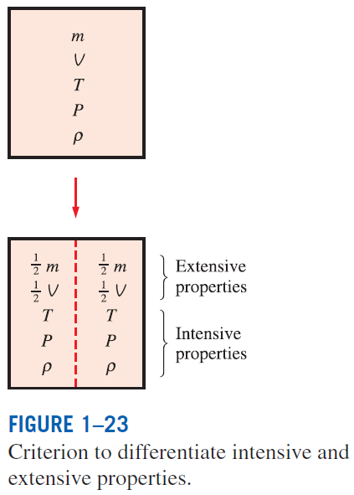


PROPERTIES OF A SYSTEM
Property: Any characteristic of a system.
Some familiar properties are pressure P, temperature T, volume V, and mass m.
Properties are considered to be either intensive or extensive.
Intensive properties: Those that are independent of the mass of a system, such as temperature, pressure, and density.
Extensive properties: Those whose values depend on the size—or extent—of the system.
Specific properties: Extensive properties per unit mass.

Slide 4
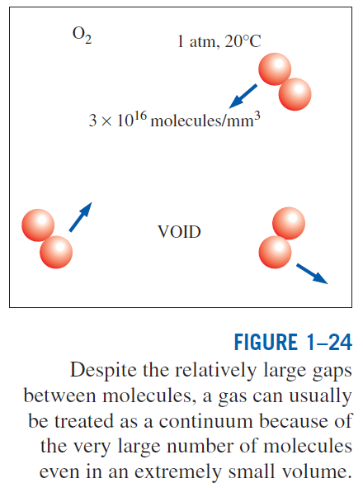
Continuum
Matter is made up of atoms that are widely spaced in the gas phase. Yet it is very convenient to disregard the atomic nature of a substance and view it as a continuous, homogeneous matter with no holes, that is, a continuum.
The continuum idealization allows us to treat properties as point functions and to assume the properties vary continually in space with no jump discontinuities.
This idealization is valid as long as the size of the system we deal with is large relative to the space between the molecules.
This is the case in practically all problems.
In this text we will limit our consideration to substances that can be modeled as a continuum.

Slide 5
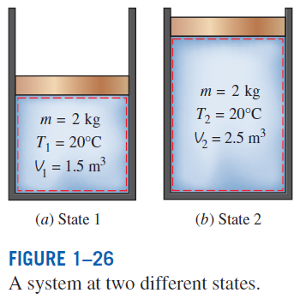
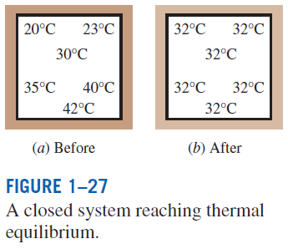
STATE AND EQUILIBRIUM
Thermodynamics deals with equilibrium states.
Equilibrium: A state of balance.
In an equilibrium state there are no unbalanced potentials (or driving forces) within the system.
Thermal equilibrium: If the temperature is the same throughout the entire system.
Mechanical equilibrium: If there is no change in pressure at any point of the system with time.
Phase equilibrium: If a system involves two phases and when the mass of each phase reaches an equilibrium level and stays there.
Chemical equilibrium: If the chemical composition of a system does not change with time, that is, no chemical reactions occur.

Slide 6
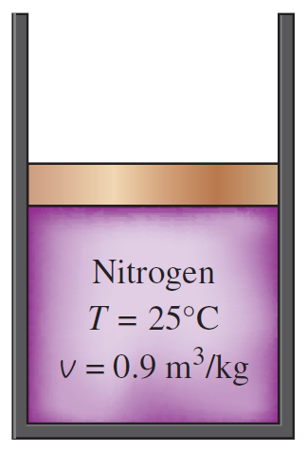
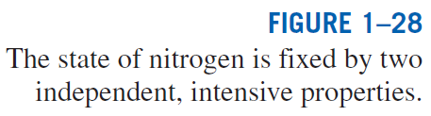
The State Postulate
The number of properties required to fix the state of a system is given by the state postulate:
The state of a simple compressible system is completely specified by two independent, intensive properties.
Simple compressible system: If a system involves no electrical, magnetic, gravitational, motion, and surface tension effects.
Notes:
Just from these 2 properties we can figure out the pressure exerted by the Nitrogen

Slide 7

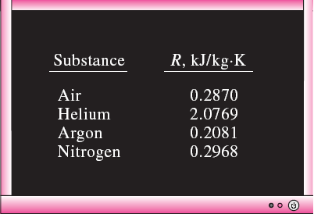
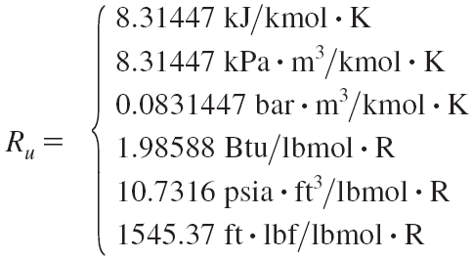
THE IDEAL-GAS EQUATION OF STATE
Equation of state: Any equation that relates the pressure, temperature, and specific volume of a substance.
The simplest and best-known equation of state for substances in the gas phase is the ideal-gas equation of state. This equation predicts the P-v-T behavior of a gas quite accurately within some properly selected region.
Ideal gas equation of state
R: gas constant
M: molar mass (kg/kmol)
R_{u}: universal gas constant
Different substances have different gas constants.

Slide 8
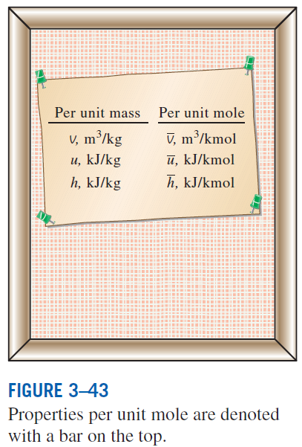
Mass = Molar mass × Mole number
Ideal gas equation at two states for a fixed mass
Various expressions of ideal gas equation
Real gases behave as an ideal gas at low densities (i.e., low pressure, high temperature).

Slide 9
Example
Before going on a long trip you should measure your tire pressure. Before you drive off you measure the (gauge) pressure in your tires and find it to be 210 kPa. The temperature of the air both outside and inside your tire is 25ºC. After traveling for a few hours, you measure the tire pressure and get a reading of 220 kPa. Assuming the tire volume does not change, what is the new temperature? Does this make sense?
Example 1

Slide 10
Example
An equipment manager for a football team fills a football with 12 psig of air in a room with a temperature of 70ºF. He also fills up another ball with 14 psig of air in the same room with the same temperature. Both balls are then taken outside where the outside temperature is 50ºF. Assuming the volume does not change, what is the new pressure in each football?
Example 2

Slide 11
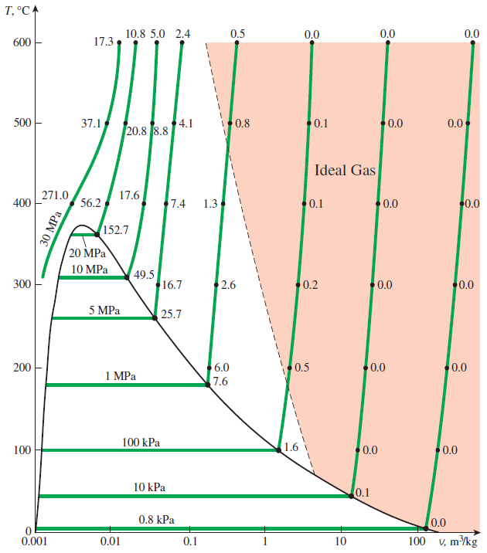
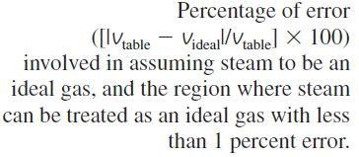
Is Water Vapor an Ideal Gas?
At pressures below 10 kPa, water vapor can be treated as an ideal gas, regardless of its temperature, with negligible error (less than 0.1 percent).
At higher pressures, however, the ideal gas assumption yields unacceptable errors, particularly in the vicinity of the critical point and the saturated vapor line.
In air-conditioning applications, the water vapor in the air can be treated as an ideal gas. Why?
In steam power plant applications, however, the pressures involved are usually very high; therefore, ideal-gas relations should not be used.

Slide 12
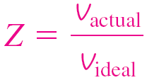
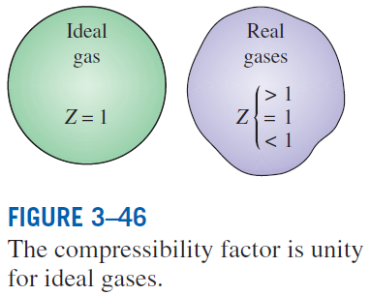
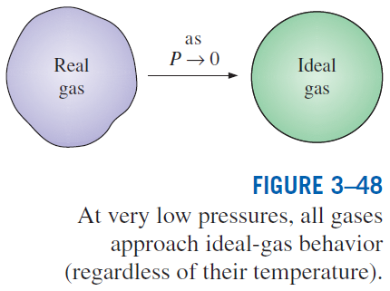
COMPRESSIBILITY FACTOR—A MEASURE OF DEVIATION FROM IDEAL-GAS BEHAVIOR
Compressibility factor Z A factor that accounts for the deviation of real gases from ideal-gas behavior at a given temperature and pressure.
The farther away Z is from unity, the more the gas deviates from ideal-gas behavior.
Gases behave as an ideal gas at low densities (i.e., low pressure, high temperature).
Question: What is the criteria for low pressure and high temperature?
Answer: The pressure or temperature of a gas is high or low relative to its critical temperature or pressure.

Slide 13
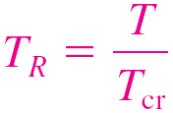
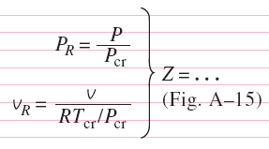
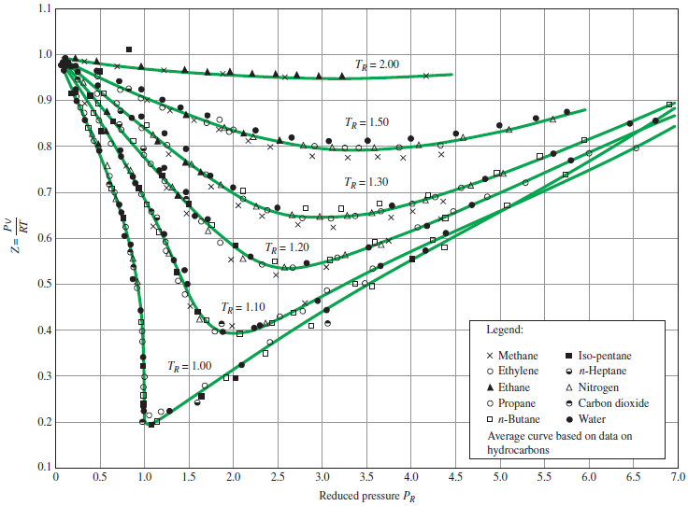
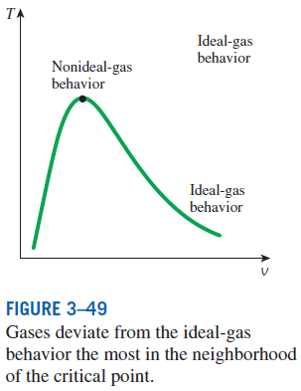
Reduced pressure
Reduced temperature
Pseudo-reduced specific volume
Z can also be determined from a knowledge of P_{R} and v_{R}.
Comparison of Z factors for various gases.

Slide 14
Example
Determine the specific volume of R-134a at 1 MPa and 50ºC. Use the ideal gas equation and also use the compressibility chart. What is it listed as in the tables in the back of your textbook?
Example 3

Slide 15
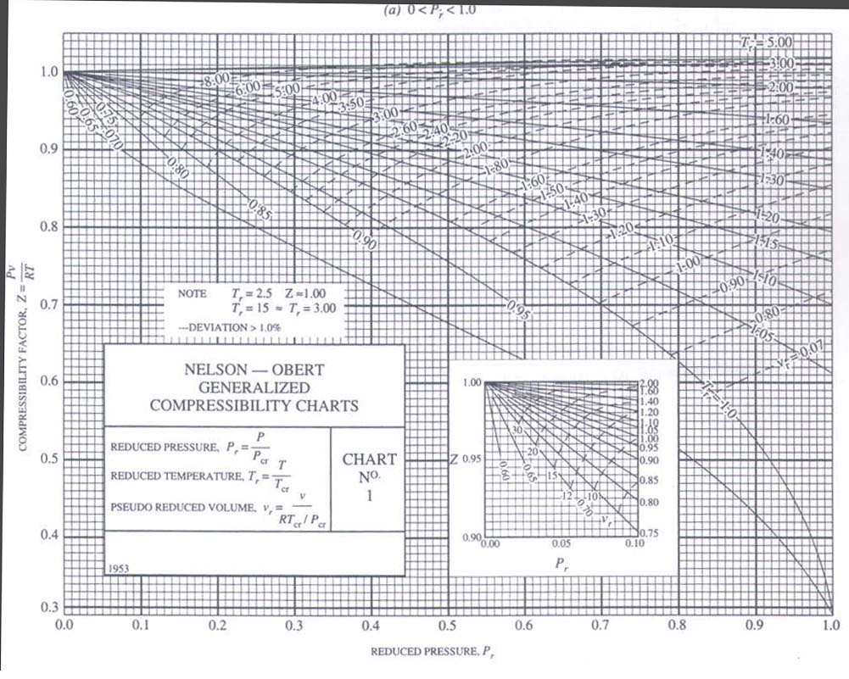
Z = 0.84

Slide 16
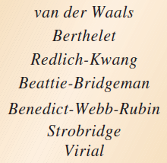
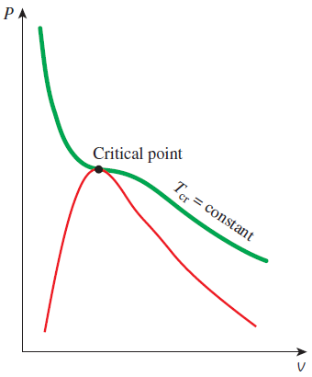
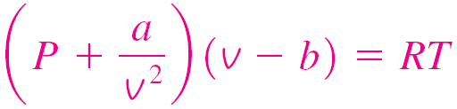
OTHER EQUATIONS OF STATE
Several equations have been proposed to represent the P-v-T behavior of substances accurately over a larger region with no limitations.
Van der Waals Equation of State
Critical isotherm of a pure substance has an inflection point at the critical state.
This model includes two effects not considered in the ideal-gas model: the intermolecular attraction forces and the volume occupied by the molecules themselves. The accuracy of the van der Waals equation of state is often inadequate.

Slide 17
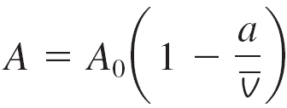
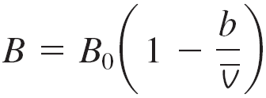
Beattie-Bridgeman Equation of State
The constants are given in Table 3–4 for various substances. It is known to be reasonably accurate for densities up to about 0.8ρ_{cr}.
Benedict-Webb-Rubin Equation of State
The constants are given in Table 3–4. This equation can handle substances at densities up to about 2.5 ρ_{cr}.
Virial Equation of State
The coefficients a(T), b(T), c(T), and so on, that are functions of temperature alone are called virial coefficients.

Slide 18
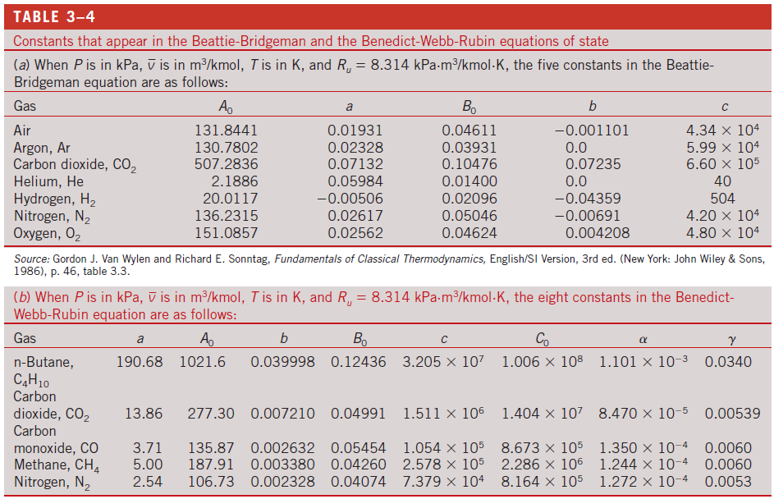

Slide 19
Pressure of N₂ at 175 K with v = 0.00375 m³/kg
Method | Value (MPa) | % error
Experimental | 10.000 | ----
Ideal Gas Eq. | 13.851 | 38.5%
van der Waals | 9.471 | 5.3%
Beattie-Bridgeman | 10.110 | 1.1%
Benedict-Webb-Rubin | 10.009 | 0.09%

Slide 20
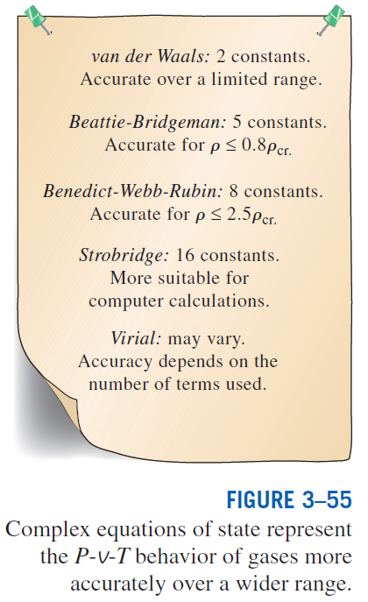

Slide 21
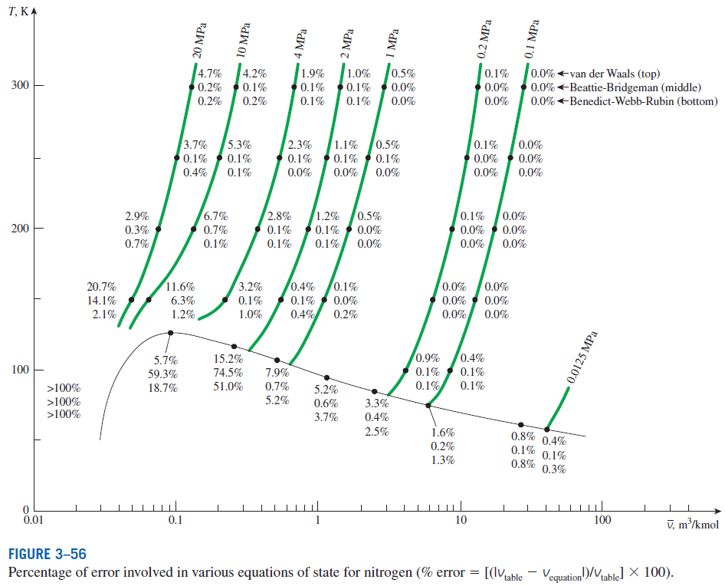

Slide 22
Boiling vs. Evaporation
We use the terms interchangeably, but they are slightly different.
Both terms refer to the phase change from liquid to vapor.
Evaporation occurs at a liquid-vapor interface when the vapor pressure is less than the saturation pressure.
Evaporation of water from a pool or lake
Sweating
Boiling occurs at a solid-liquid interface when the solid surface temperature is higher than T_{sat} for the liquid.
Boiling water on a stove top
Note that in boiling there are vapor bubbles; there are no bubbles in evaporation.

Slide 23
Summary
Properties of a system
Continuum
State and equilibrium
The state postulate
The ideal gas equation of state
Is water vapor an ideal gas?
Compressibility factor
Other equations of state
van der Waals Equation of State, Beattie-Bridgeman Equation of State
Benedict-Webb-Rubin Equation of State, Virial Equation of State
Vapor Pressure and Humidity
Difference of boiling and evaporation

